Slide 1
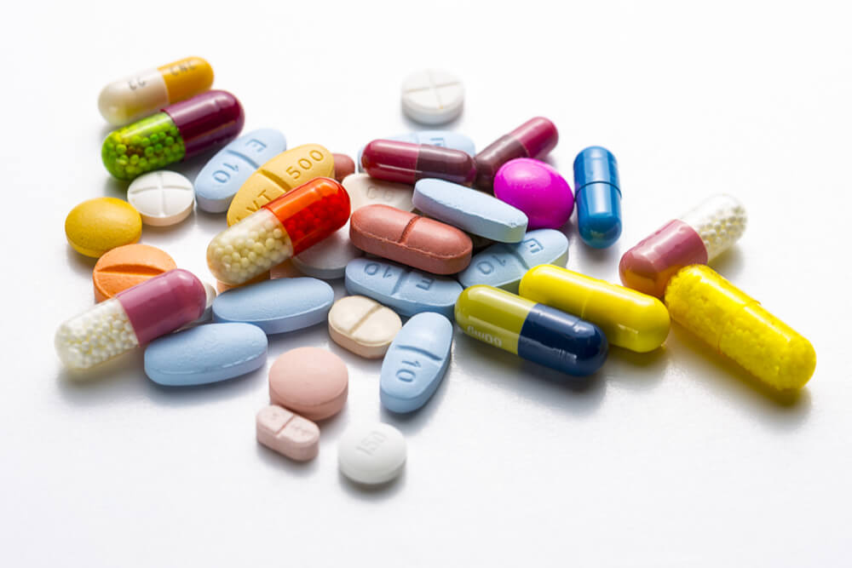
1Mg Homeopathic
Prepared By:-
Vidya Shree (pd14_173)
Aishwarya Singh Gaur (pd14_191)
Sujit Jadhav (pd13_034)
Lavesh Ranpise (pd12_004)
Hardeep Singh (pd14_063)

Slide 2
Problem Statement
For this project we have to Scrape the homeopathic medicine data from online medicine delivery platform 1mg using python library called Beautifulsoup and collect information like:
Name of the medicine
Brand name
Size of the medicine bottle
MRP of the bottle
Selling price of the bottle
1mg url where the medicine sold
Key Benefits area
User rating of the medicine
Number of people rated that product
After analyzing we have to create dashboard and from the insights we have to suggest best medicine for their store.

Slide 3
Work Flow
Data Collection Via Web Scraping
Data Cleaning
Analysis
Dashboard
Insights
We have used BeautifulSoup library in python for Data collection.
For Data cleaning we have used Python.
For analysis we have used SQL.
We have created Dashboard using Excel.

Slide 4
INSIGHTS:

Slide 5
Maximum number of medicine available is of Skin related problems.
Least number of medicine available is for problems related for legs and hand.

Slide 6
On comparing the maximum price range of all benefit area, then the max price of medicine is for hair.
On comparing the minimum price range of all benefit area, then the min price of medicine is for skin and after that hair.

Slide 7
Max price is of Dr batra brand.
Min price is of SBL brand.
Max avg price is of Bjain brand.
Max number of product is for SBL Brand.
Min number of product is for St, Essentia, Similia, Bio, REPL, Boericke, Ralson, Bahola, Germans.

Slide 9
Rating is directly proportional to discount more the discount more the rating i.e more the purchaser of that product.

Slide 10
SBL brand have the max number of reviews which are greater than 4 star.

Slide 11
CONCLUSIONS:
SBL Brand is more 4 star review:
1) Since max number of medicine are related to skin related problem this means that there is demand for medicine related to skin problem.
2) The pricing of the product is very affordable and is also available in all ranges.
3) Since the discount is also reasonable ,maximum number of customer are purchasing it.

